Slide 1
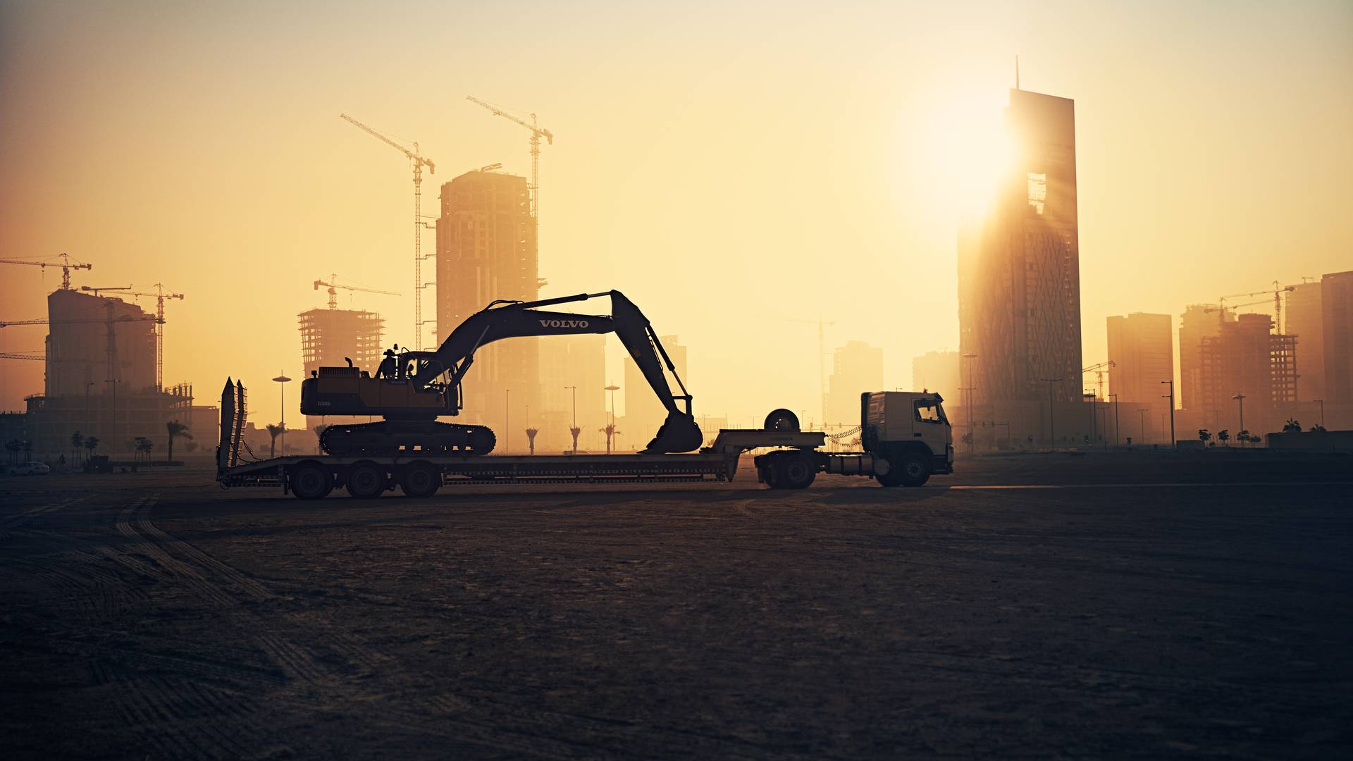
Internship Business case
August 2022

Slide 2
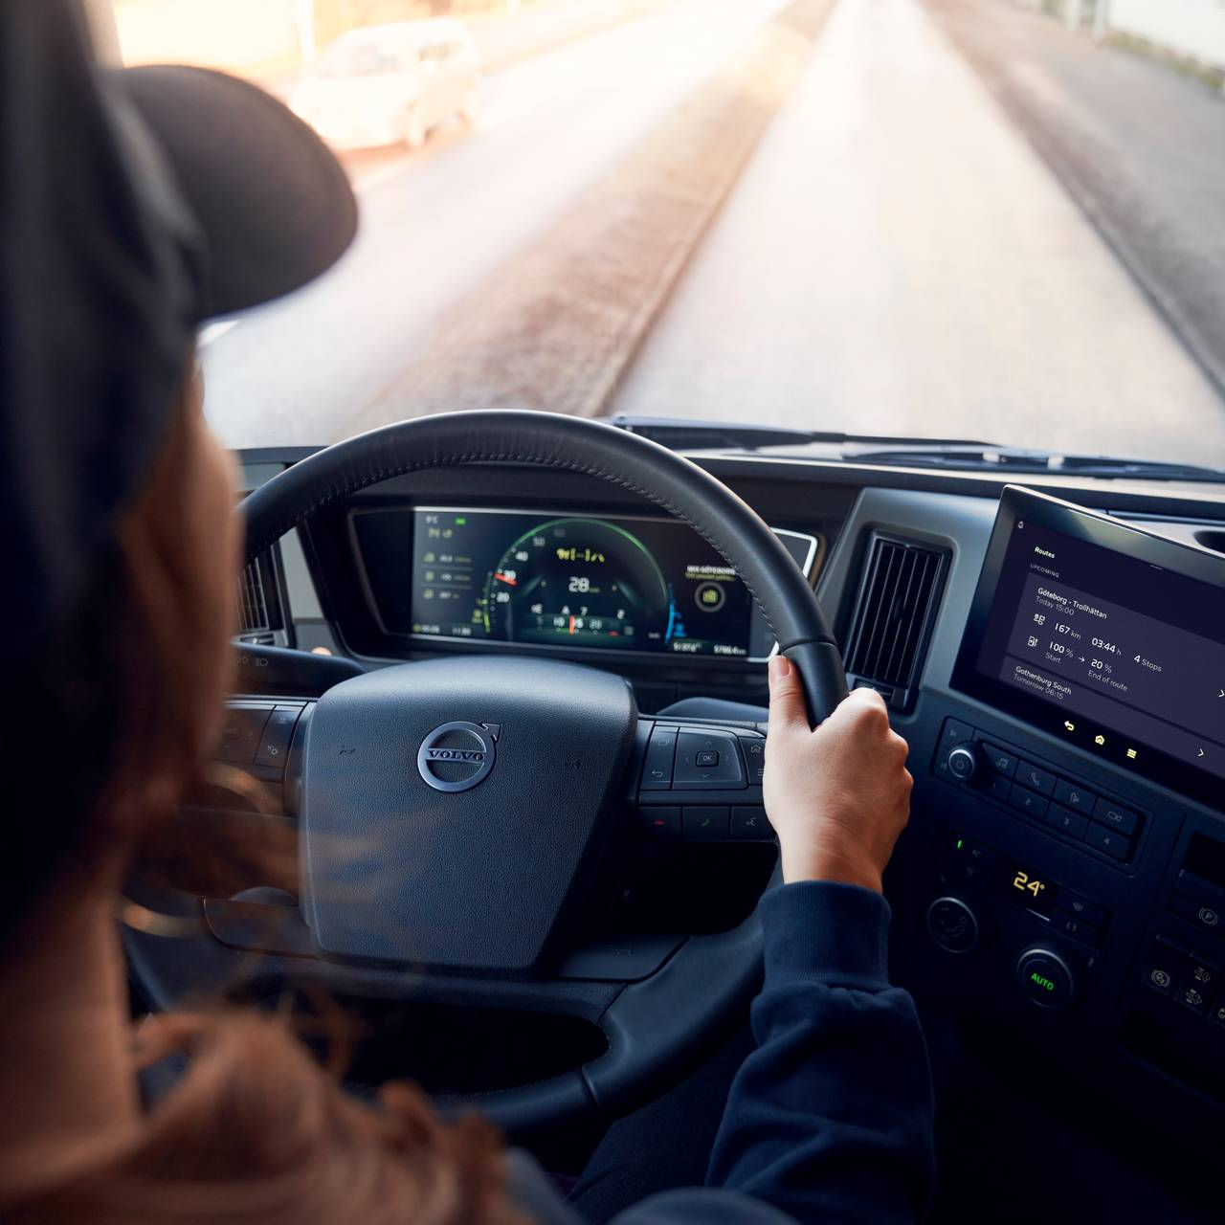
Welcome to the Volvo world!
This is an organization initiative to train fresh graduates interested in pursuing a career in the field of data. The training will happen across 2 to 3 months with exposure to various aspects of Data. It would need a commitment of approximately of 25 to 30 hours per week. The selected candidates will be assisted by mentors who will take them through key concepts along with some real life use cases from the Volvo group. There will also be evaluations that will assess the knowledge and skills gained by the candidates.
At the end of the training/internship, the candidates would gain a real world understanding of the field of data and how it is applied in the automotive domain. Based on the performance of the candidates, they could be eligible to work directly on real time projects.
As a part of the selection process, the candidates are expected to send us this completed deck in the expected time frame.
We wish you all the very best!

Slide 3
Business Task
Business Context
In our business it is of upmost importance that we fulfil our commitments towards customers.
One of our business areas (Volvo Construction Equipment) manufactures various machines, such as excavators, loaders, rollers and so forth. It is extremely important to deliver them to our customers exactly when they need them. Late delivery could mean delays in construction work carried out by our customers and early delivery may drive up storage cost. Machines are sold through dealers. 2 applications are used in the process:
FERP system used in factories which receives information from dealers about orders for specific machines and to enter information about shipped machines.
Sales system in which dealers place orders and confirm delivery of machines
The Task
Prepare a database structure (tables, relations) to store information relevant to this business process:
Master data: factories, machines, customers
Database structure in factory: Order number, order date, machine number, date of shipment
Database structure in sales system: Order number, order date, machine number, quantity, requested delivery date
Populate databases with sample data (10-20 transactions, make sure there are orders with multiple positions in them – more than one machine per order with different requested delivery dates)
Build a visualization which shows the following metrics:
Average delivery time (days) for all orders, all machines.
Average delivery time per machine type.
Top 3 orders with regards to deviation between requested and actual delivery time .
Delivery precision – percentage of order lines (positions in orders) delivered on time versus all order lines. Delivery is considered on time when requested delivery date equals actual delivery date.
Expected result
Use any database and data visualization tool that you want.
Present database structure in a graphical model to show columns and relations between them.
Present and describe reports in a picture, PDF
Useful links
Volvo Construction Equipment - https://www.volvoce.com/global/en/
Volvo Construction Equipment – product range: https://www.volvoce.com/europe/en/products/

Slide 4
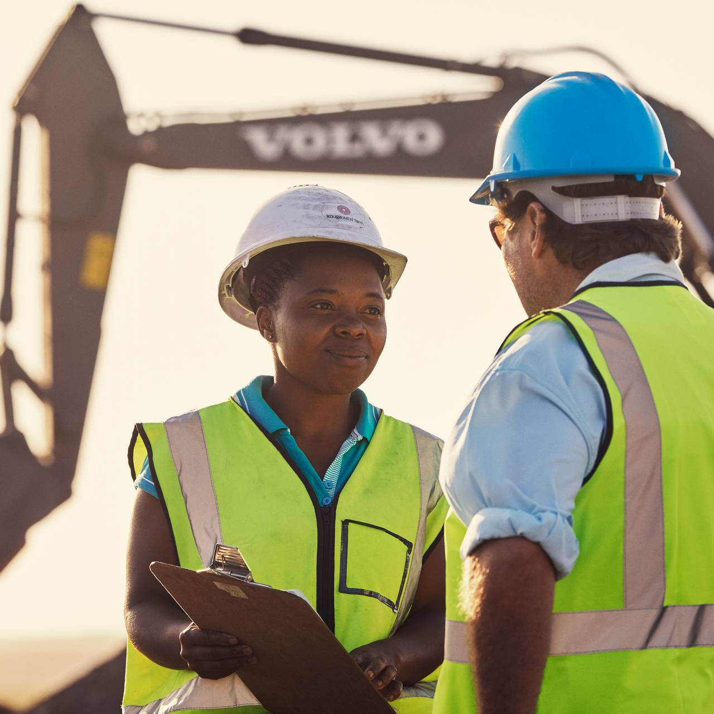
Few things to note
Please make your solution as unique as possible. The solution will be reviewed with you in case you are shortlisted for the internship/training
The business case is a situation and may not have the answer to all your queries. Please feel free to make your assumptions but do mention them in your solution
It goes without saying that there is no right or wrong answer here. We are interested in the approach you will take in finding a solution to this challenge and hence we request you to keep the ‘materials’ that were used while arriving at the solution. For us, the ‘Journey’ is more important than the ‘Destination’ ☺

Slide 5
One Pager – About me
Introduce yourself and share with us whatever you want in context of the internship:
An aspiring Data Scientist professional with a certificate in post Graduate program in Data Analytics from Imarticus Learning. An Engineer pursuing Engineering in Electronics and Communication. Possess knowledge related to Machine Learning, Artificial Intelligence, Python, Visualisation in Tableau . Additionally skilled in Communication, Critical thinking, problem-solving, Empathy and Time Management. Looking forward to showcase these skills in the Data science and data Analytics domain through “ VOLVO “ which will help me to develop and Learn and gain experience to take on an increasing amount of responsibility and make a career call
Why did you choose Volvo Group Digital & IT?
Here is a place for your answer…
A challenging environment like Volvo helps me to learn , gain experience and to test my limits , so I choose Volvo group Digital & IT
How will you contribute as an intern?
Here is a place for your answer...
As an intern i would give my fullest to Learn and gain experience to take on an increasing amount of responsibility and make a career call.
How the internship will support your development?
Here is a place for your answer…
It helps me in developing my Communication, Critical thinking, problem-solving, Empathy and Time Management skills to build myself as a Data Scientist in a fast evolving world .

Slide 6
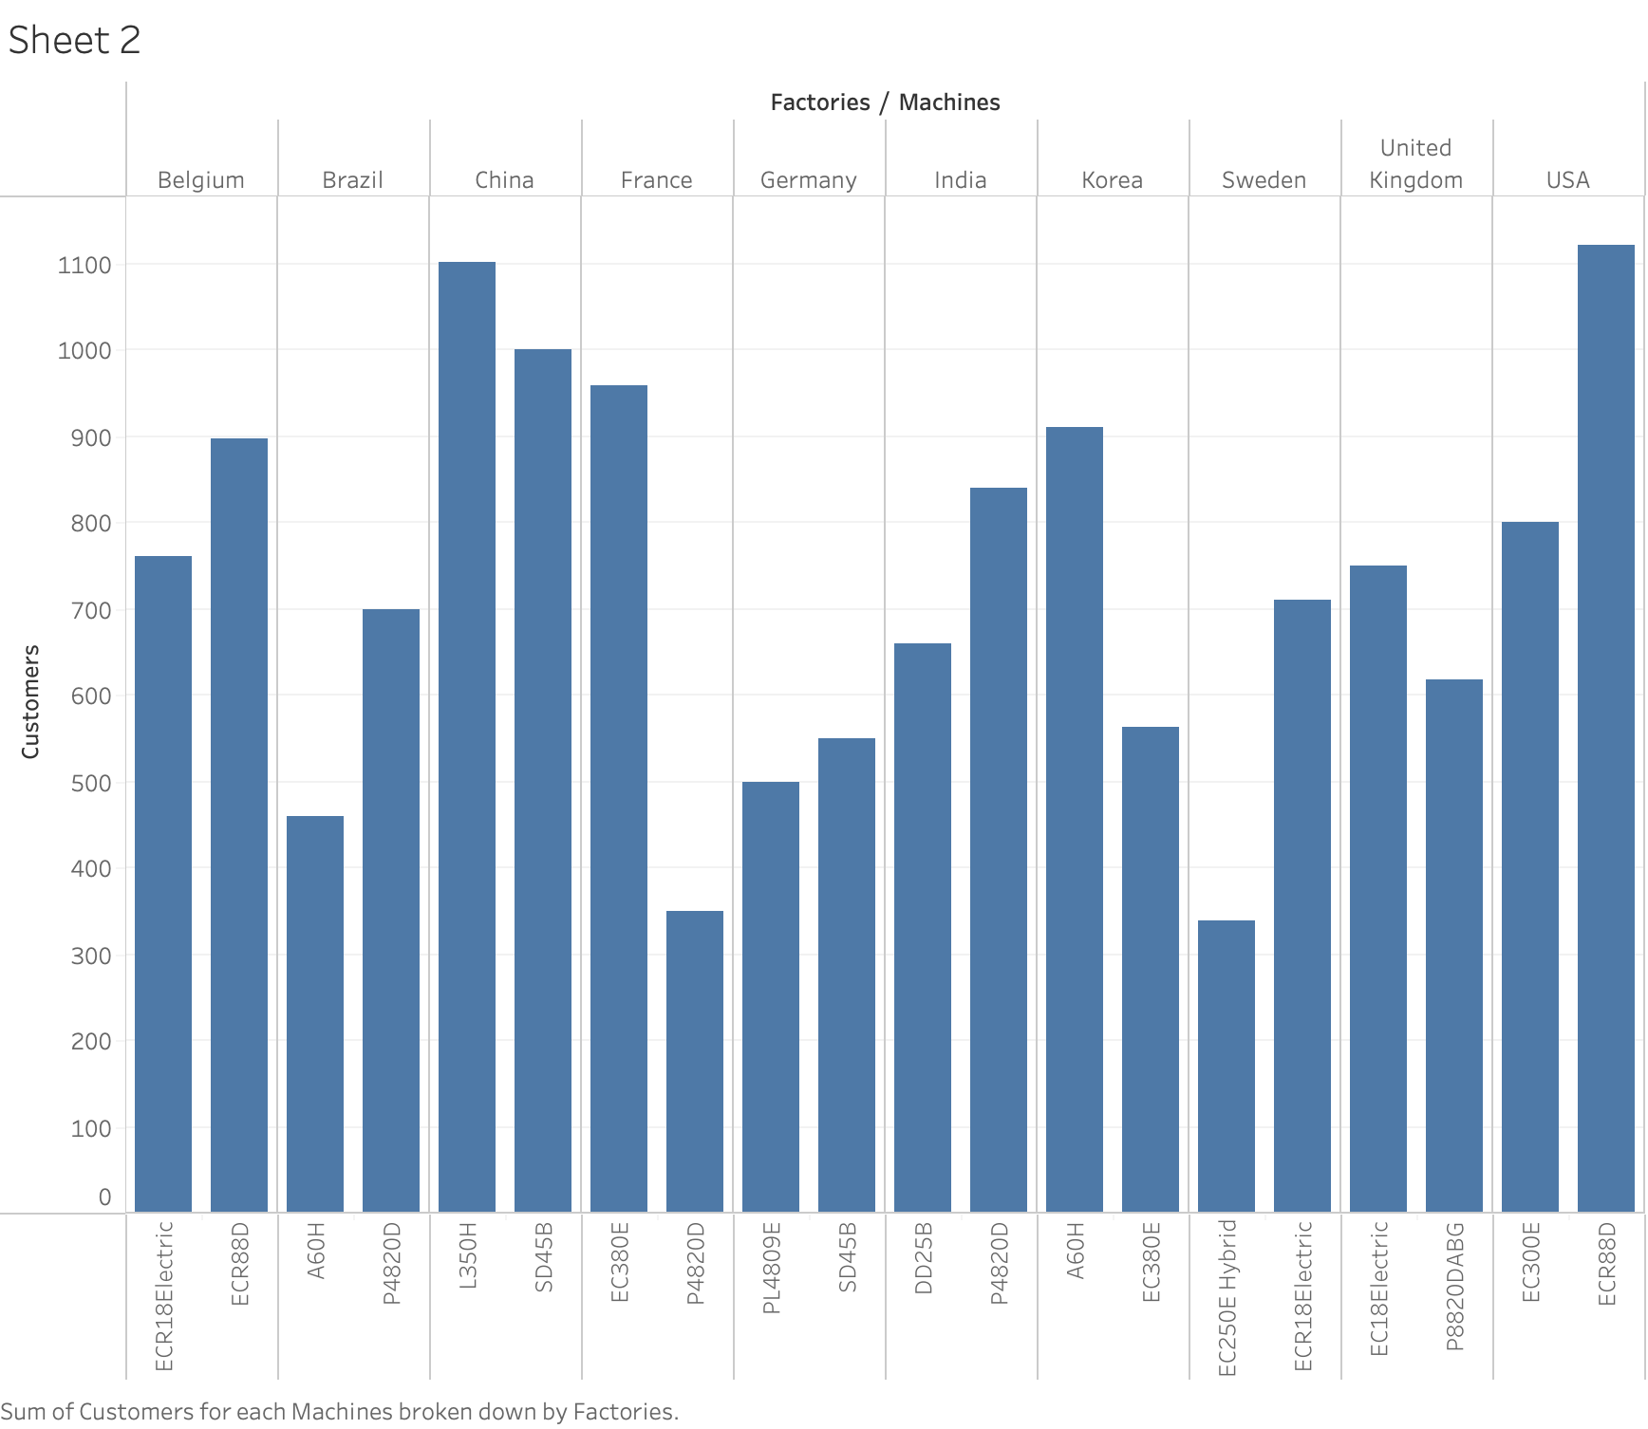
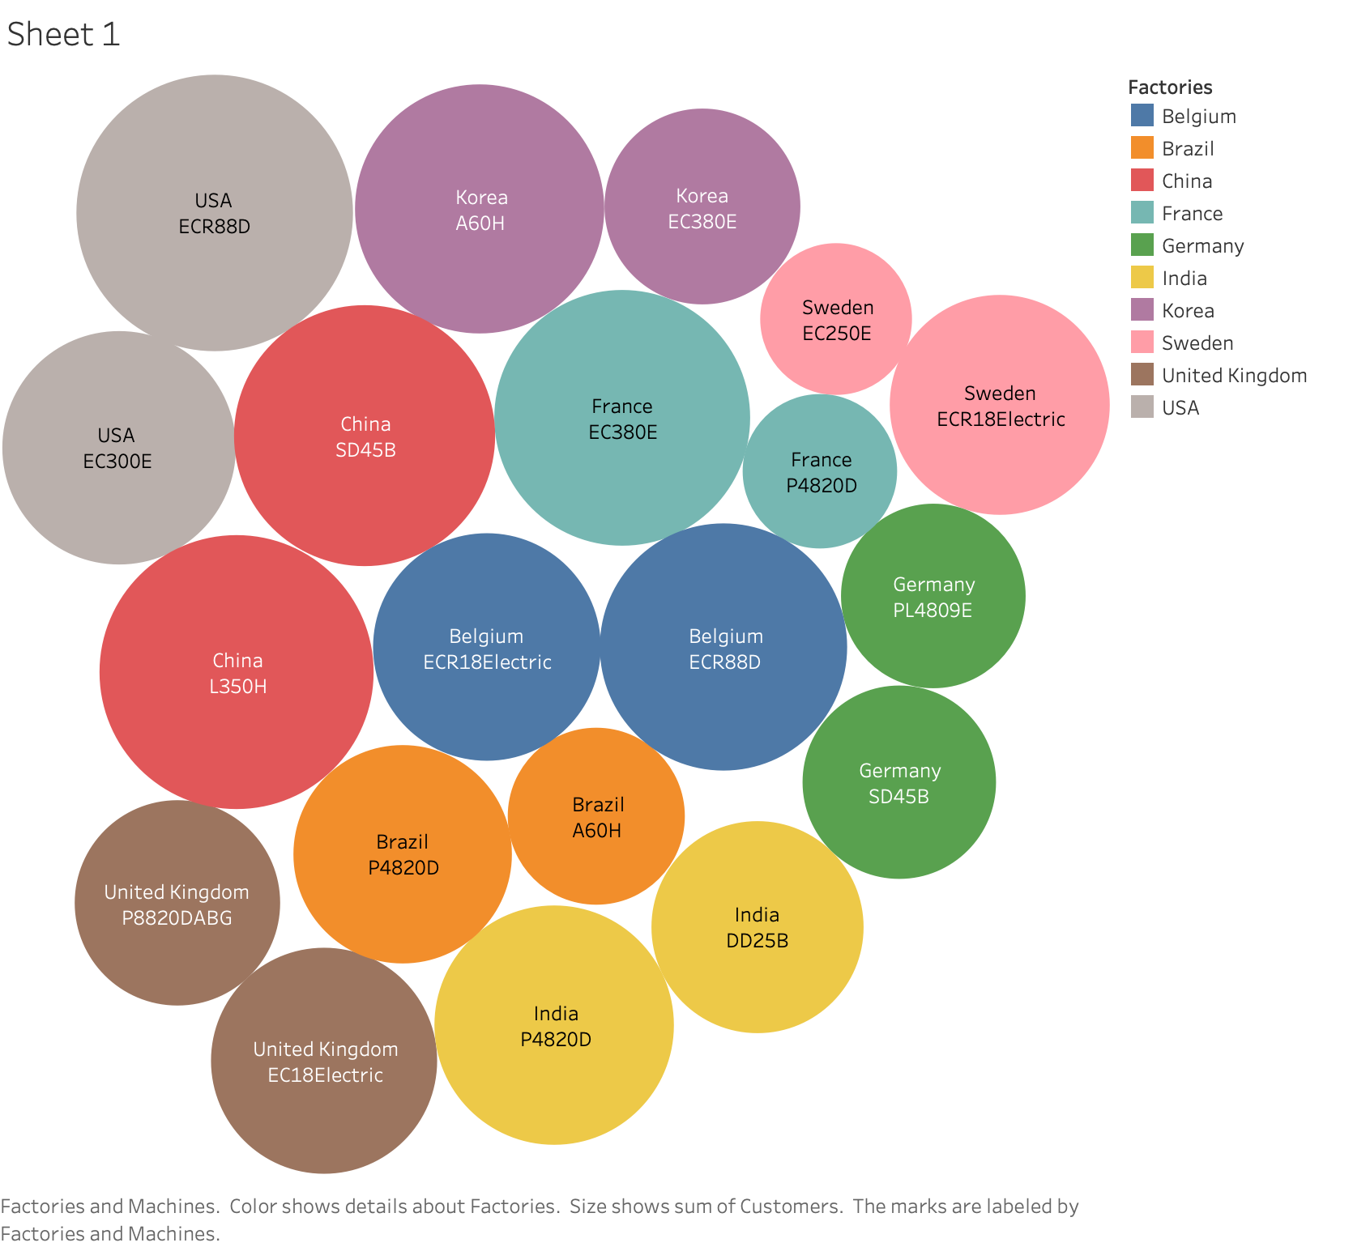
Your Solution
With help of the links sent and with informations available from Google I had derived informations for my Master data , Factory data , Sales system data . All the datas which I took are completely imaginary except for machine number which I took from your website. With these datas I had build various graphs explaining the relationship between the factories and customers , where I have visualised graphs for Average delivery time (days) for all orders, all machines , Average delivery time per machine type , Top 3 orders with regards to deviation between requested and actual delivery time . The below graphs explains about the overall Master data and understand the nature of the Master data , which helps in understanding the factory and sales data.
Here is a place for you to share something about your experience connected to the selected area. Maybe you have some related projects, achievements or academic tasks done?
I completed my PG in data analytics in Imarticus learning , while pursuing my course I had opportunity to complete 15 projects which include “ CAPSTONE - Premier League “ , “IMDB - Sentiment analysis “ , “ Image analysis “ , “ Air passengers “ , “ Black Friday “ , Hackathon , etc . Other than data analytical projects , I had presented a paper on “ BLUE BRAIN TECH “ on presentation day .

Slide 7
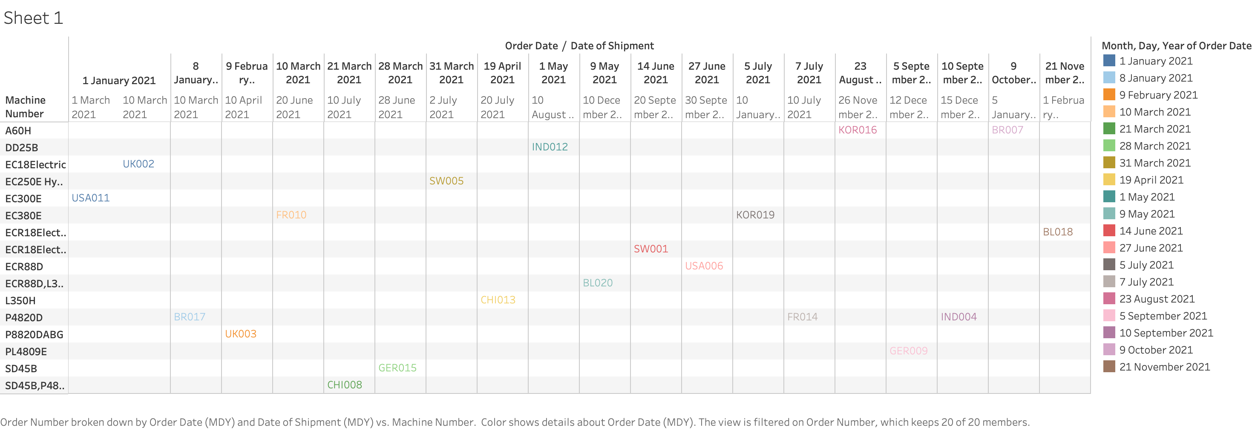
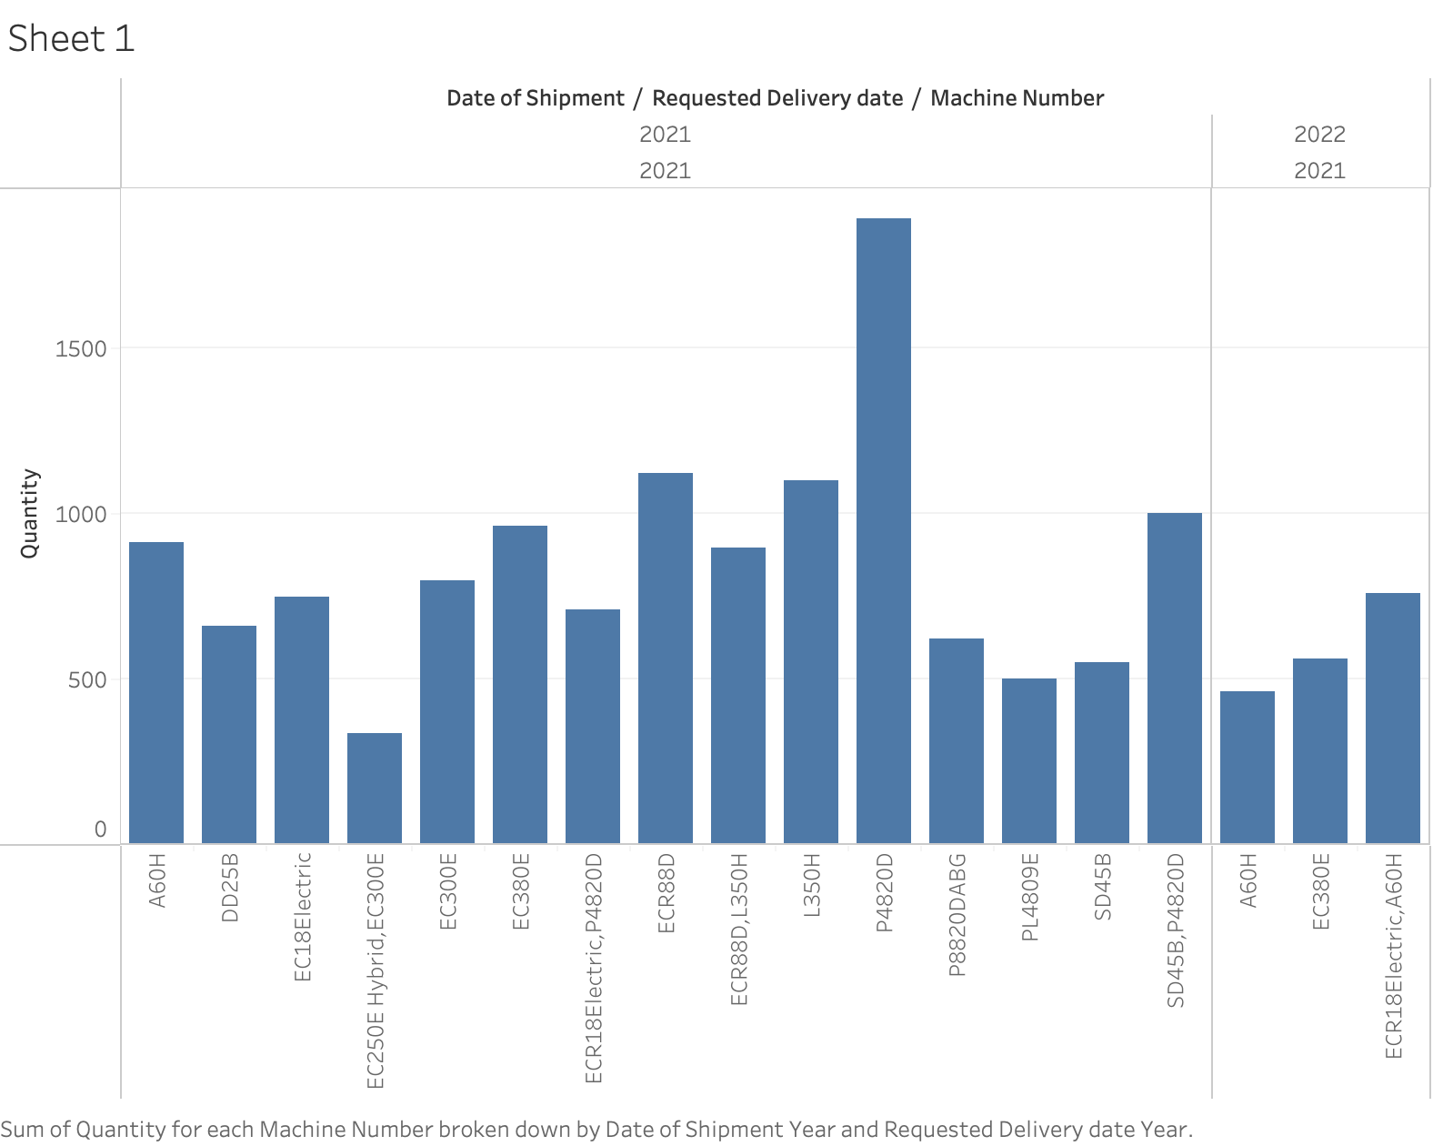
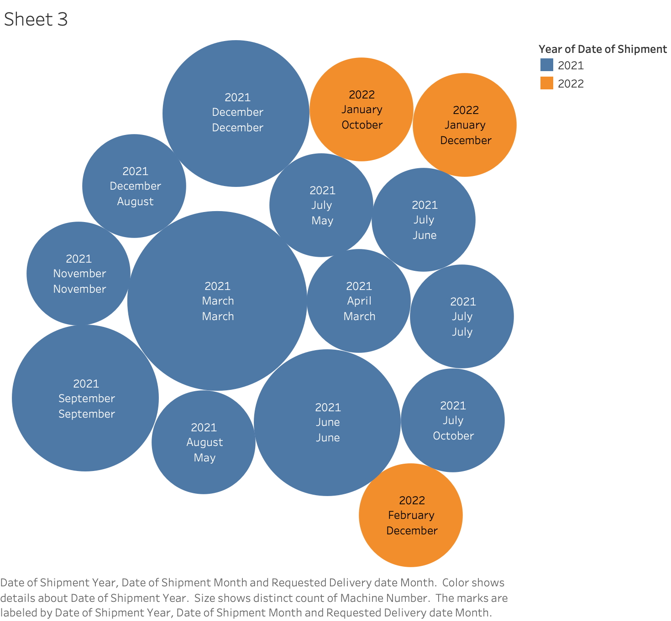
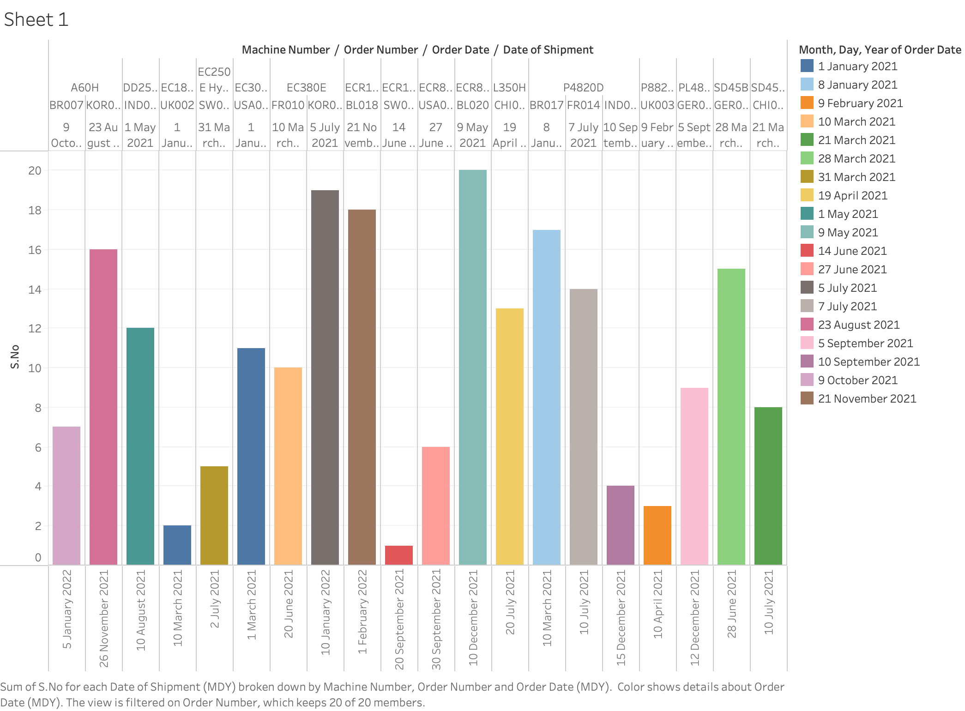
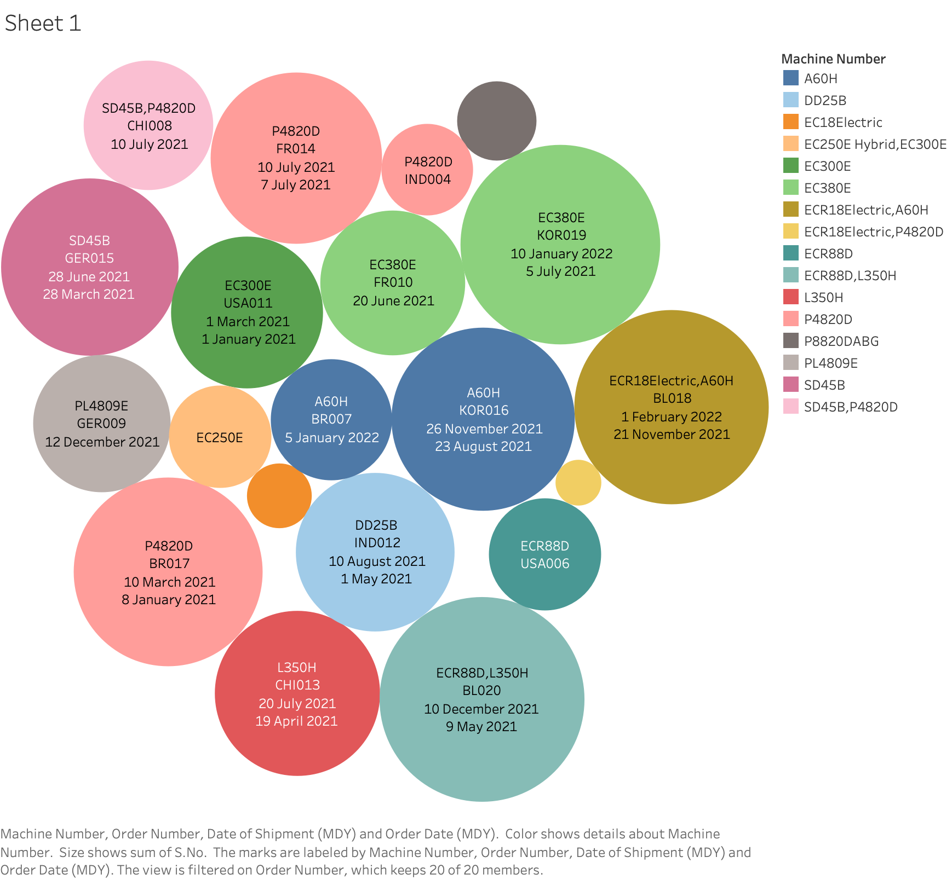
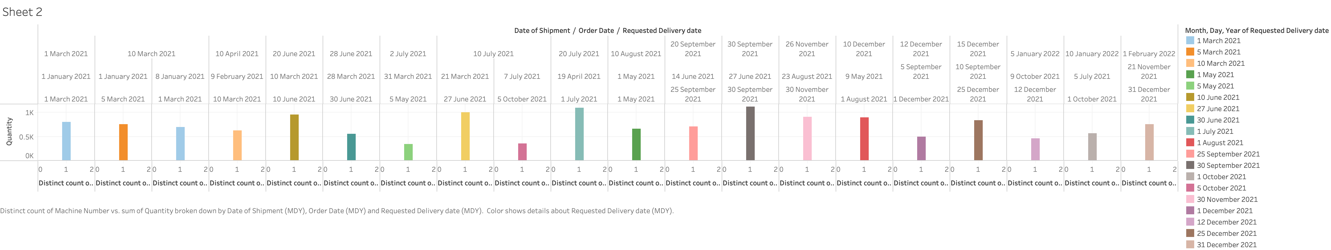
Your Solution
Factory data graph
The factory data graphs explain about the customers with the help of order number and the date of ordering the equipments and the date at which their equipments where shipped . The second graph explains the types of machines ordered by the customers in various locations and the amount of equipments ordered . The third graph explains the exact dates of the order from the customer and date at which the equipments were shipped to the customers
Sales system data graphs
All the three graphs in the sales system data explain About the Average delivery time (days) for all orders, all machines , Average delivery time per machine type, Top 3 orders with regards to deviation between requested and actual delivery time . This gives the relationship between all three data structures . I had done visualisation in Tableau . With this visualisation we explain the complete cycle of production , sales and profits and losses , according to my research the total equipment’s sold in 2021 is 14,6000 over 10 countries with a Turn over of 99.6 Billion

Slide 8
Thank you for giving me this opportunity to explain my point of view

